Slide 1
Features of Written English

Slide 2
Features of Written English
1. Complexity
2. Formality
3. Precision
4. Objectivity
5. Explicitness
6. Accuracy
7. Hedging
8. Organization
9. Planning

Slide 3
1. Complexity
i. vocabulary
Longer words; multi-syllable words. For example, it uses many ‘bigger’ words that are not normally used in conversation.
compensate, ascend and interrogate
ii. Phrases
More noun based phrases than verb based
Like all other forms of life, we human beings are the product of evolution. (noun)
Like all other forms of life, we human beings are the product of how we have evolved. ( verb & the “wh” clause)

Slide 4
Premack used a set of plastic chips to teach a chimpanzee named Sarah the meaning of a set of symbols. (Preferrable)
Premack used a set of plastic chips to teach a chimpanzee named Sarah what a set of symbols mean.

Slide 5
1. Complexity…continued
iii. Sentences structure
sentences tend to be long and complex, and grammar rules are followed strictly.
Exercise in book

Slide 6
2. Formality
Academic writing is relatively formal. In general this means in an essay that you should avoid:
a. colloquial words and expressions; ""stuff", "a lot of", "thing", "sort of",
b. abbreviated forms: "can't", "doesn't", "shouldn't"
c. two word verbs (Phrasal verbs): "put off", "bring up"
d. sub-headings, numbering and bullet-points in formal essays - but use them in reports.
e. asking questions.

Slide 7
What are Phrasal Verbs?
Phrasal verbs are verbs that consists of a verb and a particle. Particles are small words which you already know as prepositions or adverbs. Some of the most common phrasal verb particles are:
About, around, at, away, back, down, for, in, into, off, on, out, over, through, to, up.

Slide 8
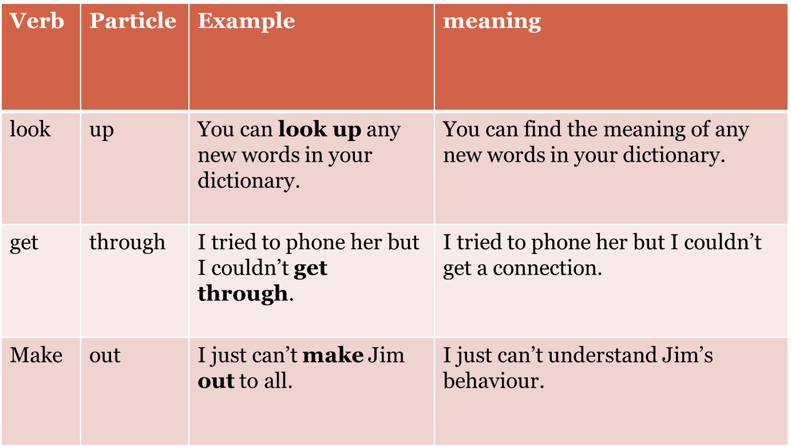

Slide 9
3. Precision
In academic writing, facts and figures are given precisely. In academic writing you need to be precise when you use information, dates or figures.
pets like cats, dogs, etc. 🡪 pets, such as cats and dogs,
around half of the group 🡪 approximately 53% of the group

Slide 10
4. Objectivity
• Caution
Our study proves that 🡪This study shows that
I’m sure this is so. 🡪There is reason to believe that this is so.
We really couldn’t make anything of the results. 🡪There were difficulties in analyzing the results.
• Lack of emotion (an objective, unemotional stance)
I think that this idea is disgusting. 🡪This idea may not be accurate.
In my opinion this is a wonderful topic. 🡪This topic is worth investigating because….
Personal Pronouns
Avoid words like “I”, “me”, “myself”

Slide 11
5. Explicitness
Academic writing is explicit in several ways. It is explicit in its signposting of the organisation of the ideas in the text.
1. We use transitional words:
Argument - However, On contrary
Reason - beacause
Similaritiy of ideas- similarly
Order: first, second, third; initially, finally; as stated in section 1; as will be demonstrated…
Consequence: therefore, accordingly, thus, hence…
Contrast: instead, in contrast, on the other hand…
Concession: however, nevertheless, all the same…

Slide 12
5. Explicitness
2. Acknowledgement of sources
Do THIS in academic writing
McGreil (1977: 363-408) has shown that though Dubliners find the English more acceptable than the Northern Irish, Dubliners still seek a solution to the Northern problem within an all-Ireland state.
NOT
Although Dubliners find the English more acceptable than the Northern Irish, Dubliners still seek a solution to the Northern problem within an all-Ireland state.
NOT
Researchers have shown that though Dubliners find the English more acceptable than the Northern Irish, Dubliners still seek a solution to the Northern problem within an all-Ireland

Slide 13
6. Accuracy
Contextual Meaning
Context: How words and their meanings are connected to each other in a written work
Most words have more than one meaning. The meaning of a word is determined through its contextual use; the words in the sentence that surround the word you are trying to define will give you contextual clues to help you define the word’s meaning. A word is defined within the context of a sentence. You must also pay attention to whether the word is used as a noun, adjective, or adverb.

Slide 14
Example: Gauge
The driver looked at his gas gauge and realized that he needed to make a pit stop to fill up if he wanted to win the race.
The store owner was not about to be the victim of a robbery, so he kept a 12-gauge shotgun within arm’s reach under the counter near the cash register.
The candidate for governor did not know how the public felt about additional taxes to build more schools, so he polled one thousand people to gauge the general attitude toward his proposition.

Slide 15
Example: Snake
I was startled by a large black and yellow snake that was in the back yard sunning itself. My father told me that it was harmless, and that I should just leave it alone.
The man was a snake in his business dealings with the elderly couple. They ended up signing a contract for five thousand dollars for a new garage door when they could have purchased the same door for one thousand from another dealer.
The road snaked around the edges of the mountain. When I looked down I felt that we would slip over the side of the precipice at any moment.

Slide 16
7. Hedging
An important feature of academic writing is the concept of cautious language, often called "hedging" or "vague language". In other words, it is necessary to make decisions about your stance on a particular subject, or the strength of the claims you are making.
1. | Introductory verbs: | e.g. seem, tend, look like, appear to be, think, believe, doubt, be sure, indicate, suggest
2. | Certain lexical verbs | e.g. believe, assume, suggest
3. | Certain modal verbs: | e.g. will, must, would, may, might, could
4. | Adverbs of frequency | e.g. often, sometimes, usually
4. | Modal adverbs | e.g. certainly, definitely, clearly, probably, possibly, perhaps, conceivably,
5. | Modal adjectives | e.g. certain, definite, clear, probable, possible
6. | Modal nouns | e.g. assumption, possibility, probability
7. | That clauses | e.g. It could be the case that . e.g. It might be suggested that . e.g. There is every hope that .
8. | To-clause + adjective | e.g. It may be possible to obtain . e.g. It is important to develop . e.g. It is useful to study .

Slide 17
8. Organization
Academic writing is well organised. It flows easily from one section to the next in a logical fashion. A good place to start is the genre of your text. Once you have decided on the genre, the structure is easily determined.
The following genres are common in higher education.
Essays
Reports
Case Studies
Research proposals
Book reviews
Brief research reports

Slide 18
7. Literature reviews
8. Reflective writing
9. Introductions
10. Research methods
11. Research results
12. Research discussions
13. Writing conclusions
14. Research abstracts
15. Research dissertations & theses

Slide 19
9. Planning
Pre- writing
Writing
Post- writing

Slide 20
Below are sentences that have informal words in them. Circle the informal word or words and rewrite the sentence in a formal style.
1) They bought an awesome house around the corner.
2) There were lots of people at the museum.
3) Jane ain’t going to tell anyone.
4) Oscar started freaking out about the test.
5) When the cops arrived, the crook ran outside.
6) He checked his cell for any messages.
7) The family chilled by the pool all afternoon.
8) She bought a bunch of stuff at the mall.

